Slide 1
OGP Local – Georgia’s Experience and Success Stories
Western Balkans Regional meeting
Kety Tsanava – The Head of OGP Georgia Secretariat, Public Administration Division,
Administration of the Government of Georgia

Slide 2
Key Reasons Why OGP Started OGP Local Program – Our Perspective
Local governments are closer to the people and their work has a direct impact on citizen’s everyday lives
Local governments have to ensure that the services they provide to the local population are effective, citizen-oriented and tailored to their needs
Through OGP Local Platform members learn how to introduce Open Government principles such as transparency, accountability, and responsiveness at local government level
OGP Local program helps to build partnerships between local governments and local CSOs
OGP Local provides the opportunity to its members to collaborate with representatives from different countries, share their knowledge and learn from others

Slide 3
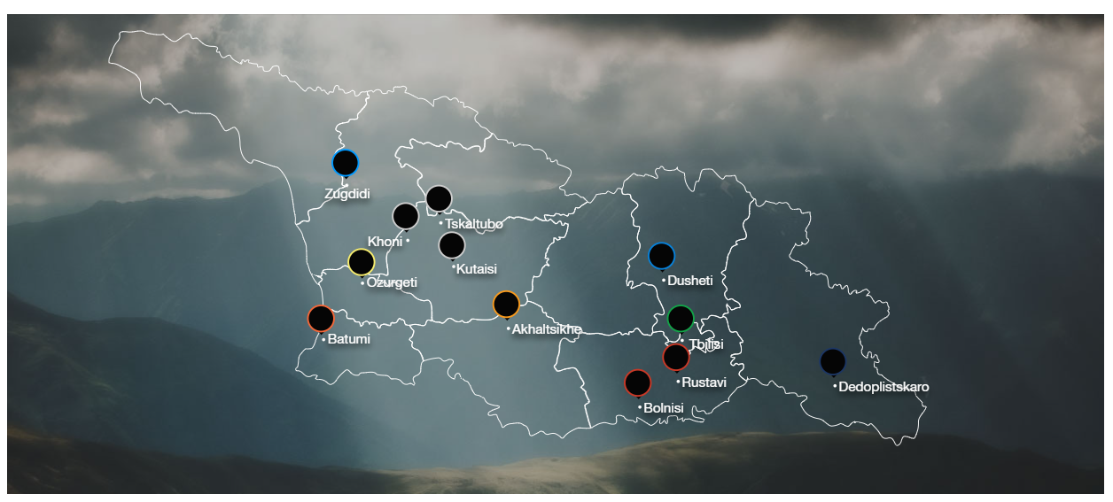
Involvement of Local Municipalities in the OGP Georgia’s Process
OGP Georgia Action Plan 2016-2017 - the first document to have commitments of 5 municipalities as a separate, independent component.
OGP Georgia Action Plan for 2018-2019 - involvement at the local level has increased and commitments of 11 municipalities were included in the AP

Slide 4
How the Local Municipalities were Included in the OGP Georgia Action Plans
OGP Georgia Action Plan 2016-2017
As a result of public consultations as well as taking into account recommendations of NGOs involved in the process, the Secretariat started cooperation with 5 Municipality Assemblies & included their commitments in the Action Plan
OGP Georgia Action Plan 2018-2019
With co-organization of the USAID, OGP Georgia Secretariat and the Ministry of Regional Development and Infrastructure of Georgia, a meeting with all Georgian municipalities was held. The meeting covered the challenges and opportunities of the open government at local level
Peer-to-peer exchange
As a result, the number of municipalities involved in OGP processes has increased from 5 to 11

Slide 5
Examples of Achievements at Municipal Level as a Result of Successful Collaboration
Transparency and Integrity Strategies along with their Action Plans were developed and introduced in 5 municipalities
Open Data Action Plan and Monitoring Framework were developed and introduced in Akhaltsikhe and Kutaisi municipalities
5 new electronic services were introduced in the city of Batumi municipality
Institutional mechanisms of participatory budgeting were introduced in Batumi; An electronic platform – www.idea.batumi.ge was developed
Application of innovative methods for effective governance and civic engagement was launched in Ozurgeti municipality
A multifunctional mobile application –I.Gov.Zugdidi was launched in Zugdidi municipality

Slide 6
Georgia’s Participation in OGP Local
Tbilisi Municipality City Hall became involved in OGP pilot program for local self-governments in 2016.
The capital was among 15 cities selected among the 45 candidates in the world
In October, 2020, Akhaltsikhe, Khoni and Ozurgeti municipalities became new members of OGP Local.
Out of the 112 applications received, based on pre-defined criteria the selection committee selected 56 members
In 2021 OGP Local member municipalities of Georgia submitted their first Action Plans

Slide 7
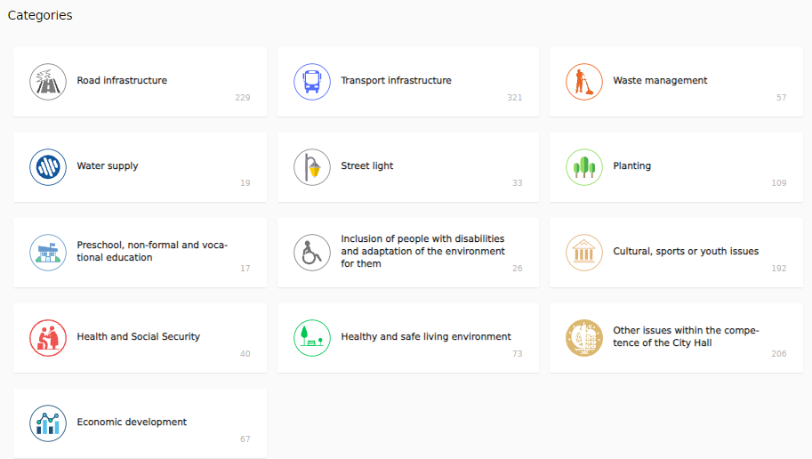
Georgia’s Success Stories in OGP Local
Tbilisi City Hall developed the First Action Plan in 2017, within the scope of which a portal of petitions – Your Idea for the City Mayor was created
The portal enables citizens to present their ideas or to support their co-citizens’ initiatives and to take part in city development.

Slide 8
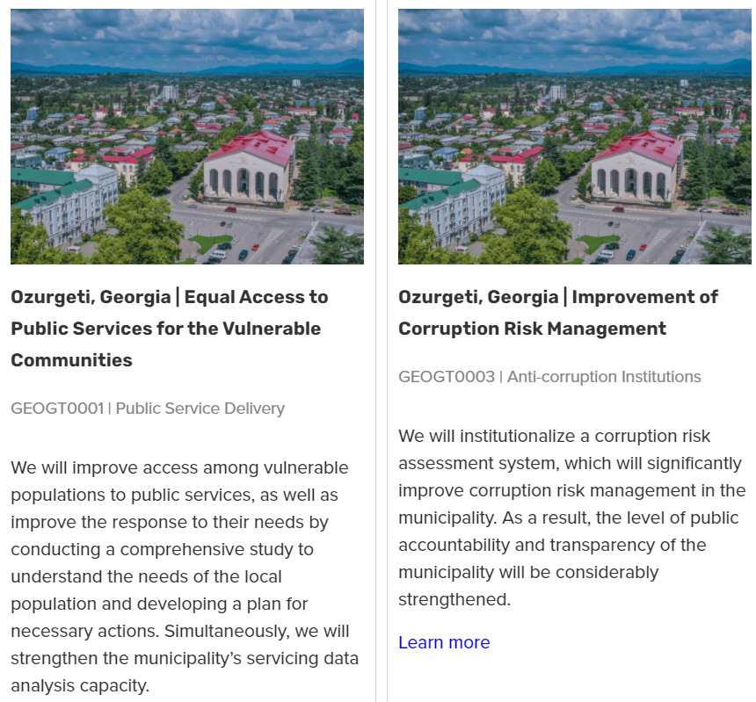
Ozurgeti Municipality at “OGP Local Innovations Award”
Ozurgeti Municipality, as a member of the OGP Local Program, has submitted two commitments for the “OGP Local Innovation Award”
The commitments submitted by the municipality should be implemented by the end of 2021 and cover OGP thematic areas such as: Improving Public Service Delivery and Fighting Against Corruption

Slide 9
Thank you!
ktsanava@gov.ge

